Slide 1
Time Series Analysis and Forecasting
Forecasting Consumer Price Index
Bimalsen Rajbhandari

Slide 2

Consumer Price Index (CPI)
Definition
The CPI is a measure of the prices of a basket of goods and services that are typically purchased by consumers.
Importance of Forecasting CPI
Crucial for understanding and managing inflation
Informs economic policies
Facilitates wage adjustments
Affects investment decisions,
Indicator of the economy's and its participants' stability and well-being.

Slide 3
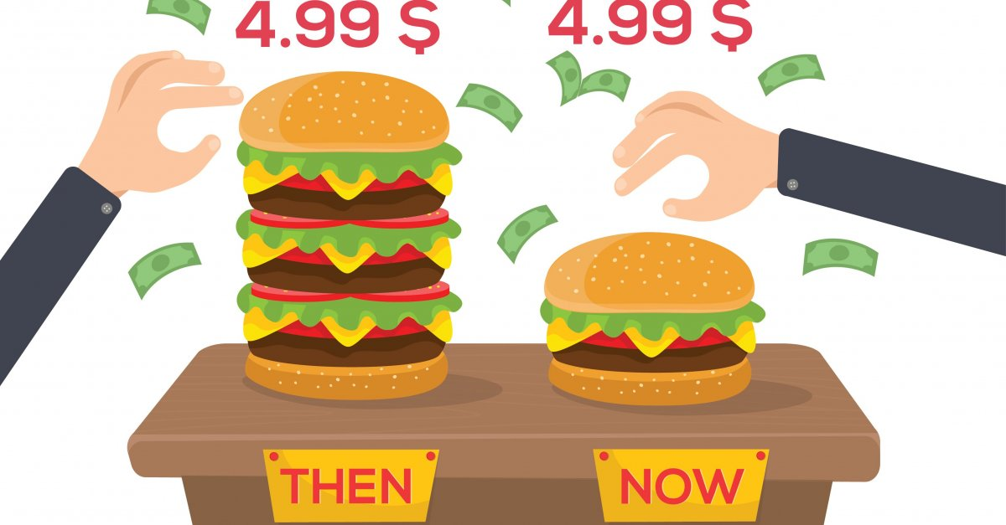
Problem Statement
Goal
Predict the US (CPI) from Jan 2021 to July 2021
Problem
Basket of goods and services constantly changing, as new products are introduced and old products are discontinued making it difficult to accurately predict the CPI
CPI is also affected by various factors, including economic growth, interest rates, and government policies. These factors can change rapidly, making it difficult to predict how they will affect the CPI.

Slide 4
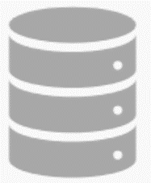
Data
The data was pulled from Kaggle
The data contains the monthly US CPI from 1913 to July 2021

Slide 5
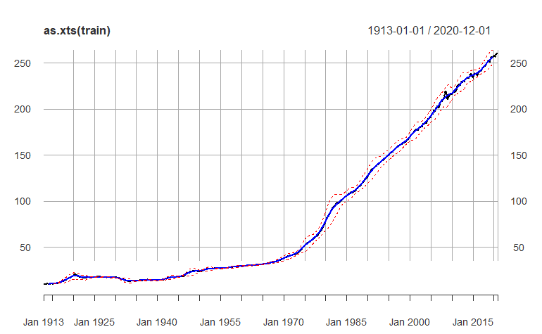
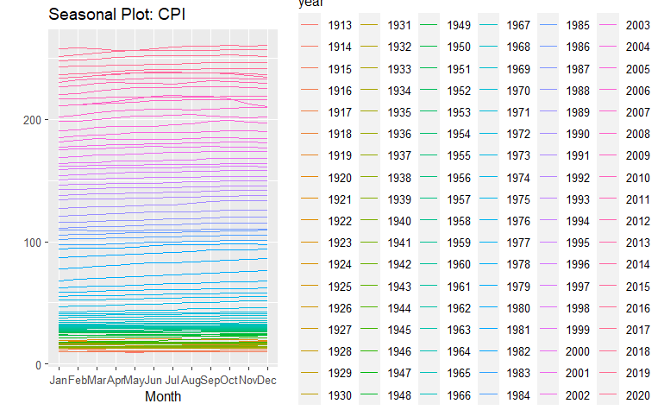
Exploratory Data Analysis
Stationary Check
Clear upward trend, especially starting from 1970
Seasonality doesn’t seem to be present, but it might be masked by the strong trend
Notes:
Hello professor and colleagues, we are the William Blair team tasked with improving the analytics of the firm.
William Blair is the premier boutique investment bank focused on middle market growth companies.
Here, Blair generates fees providing M&A advisory, as well as, raising capital through debt and equity markets
Unlike the bank's largest competitors and closest peers like Goldman Sachs, William Blair is a privately held partnership. Here, the partners risk their own capital to acquisitions, fund IPO's while providing M&A advisory.

Slide 6
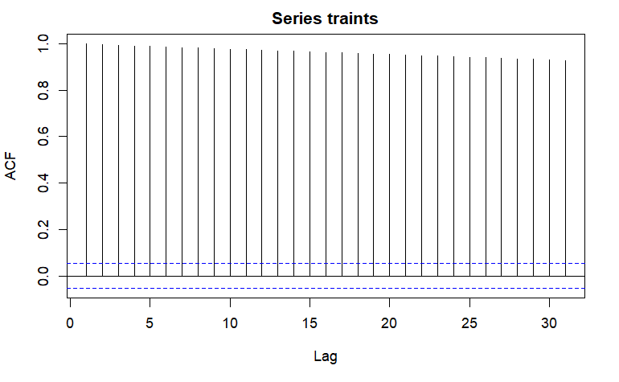
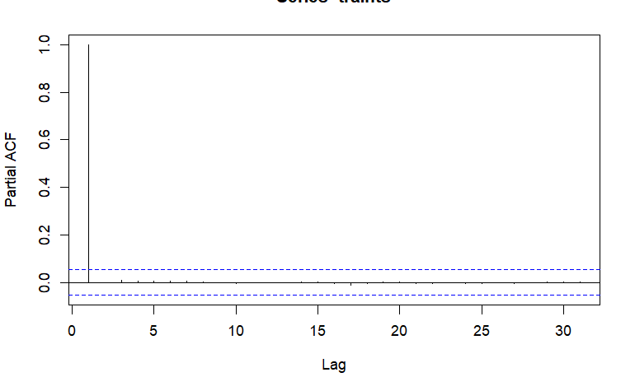

Exploratory Data Analysis
Stationary Check
Both the quantitative and qualitative checks agree that there is autocorrelation
Notes:
Hello professor and colleagues, we are the William Blair team tasked with improving the analytics of the firm.
William Blair is the premier boutique investment bank focused on middle market growth companies.
Here, Blair generates fees providing M&A advisory, as well as, raising capital through debt and equity markets
Unlike the bank's largest competitors and closest peers like Goldman Sachs, William Blair is a privately held partnership. Here, the partners risk their own capital to acquisitions, fund IPO's while providing M&A advisory.

Slide 7
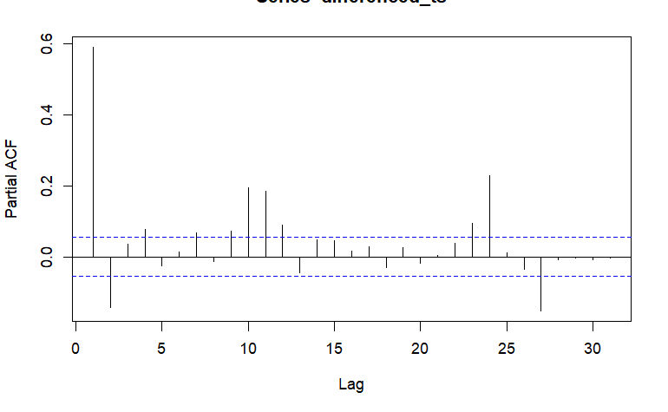
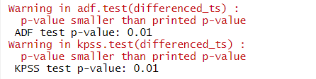
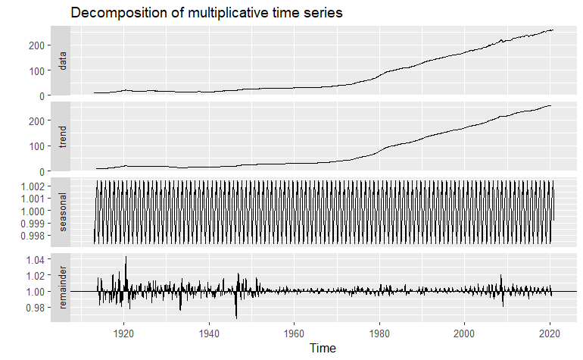
Exploratory Data Analysis
After differencing the timeseries with lag=1, PACF and ADF now suggest stationary. ADF suggest stationary, but KPSS disagrees, which implies a trend stationary time series
We now see seasonality in differenced time series, which makes sense as prices of goods and services can exhibit seasonality. The seasonality may be more pronounced in the differenced data because the trend component has been removed
Notes:
Hello professor and colleagues, we are the William Blair team tasked with improving the analytics of the firm.
William Blair is the premier boutique investment bank focused on middle market growth companies.
Here, Blair generates fees providing M&A advisory, as well as, raising capital through debt and equity markets
Unlike the bank's largest competitors and closest peers like Goldman Sachs, William Blair is a privately held partnership. Here, the partners risk their own capital to acquisitions, fund IPO's while providing M&A advisory.

Slide 8
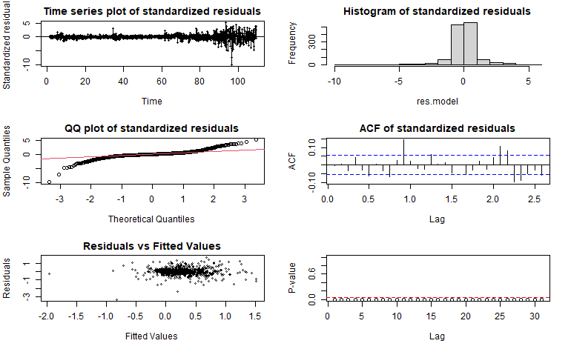
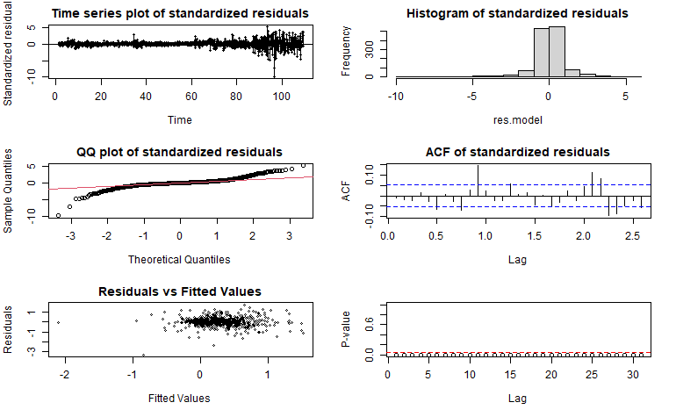
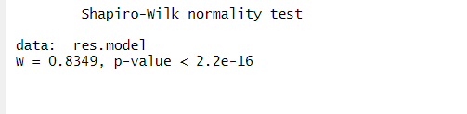
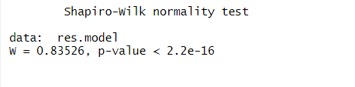
Model 1&2: SARIMA
SARIMA Model
SARIMA can be great if there TS has trend stationary and has a seasonal and trend component
Fitted two SARIMA models based on the best AICc and BIC score
Normality and Heteroscedasticity
Looking at residual plots , McLeod.Li.test and the Shapiro-Wilk test, both models violated normality and Homoscedastic assumptions. We already know that the differenced_ts is trend stationary

Slide 9
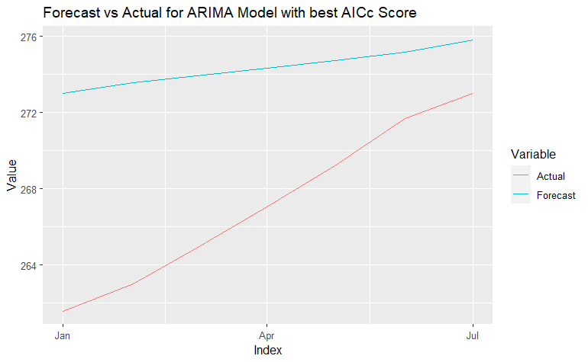
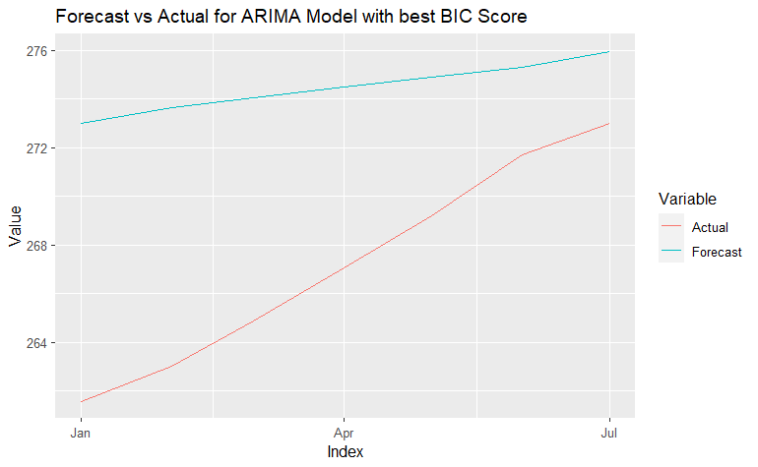
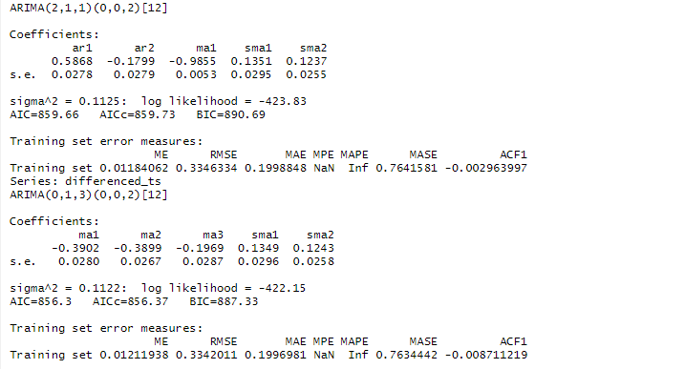


Model 1&2: SARIMA
Both SARIMA Models have similar forecast and accuracy

Slide 10

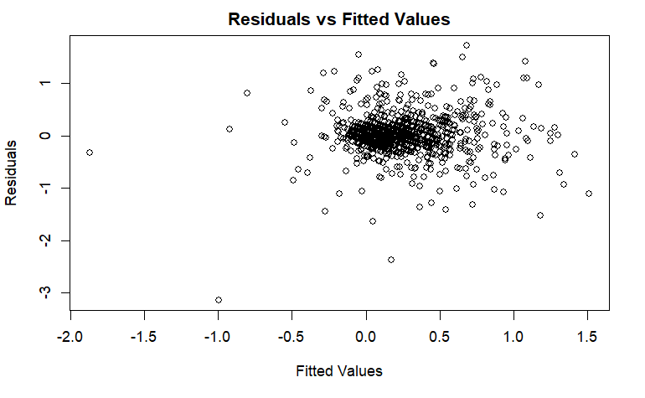
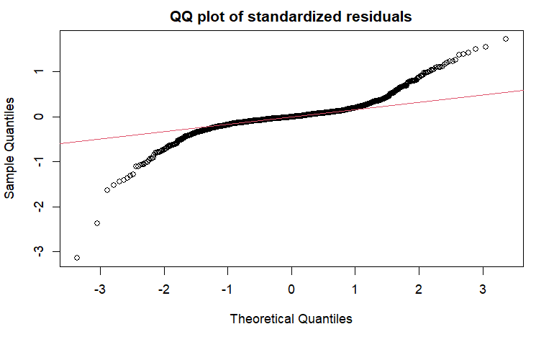
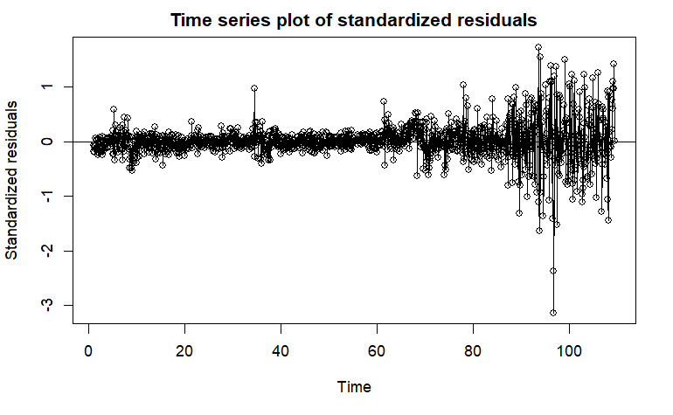
Model 3: ARFIMA
ARFIMA Model
ARFIMA includes long memory or long-range dependence in the data that might improve my model
Normality and Heteroscedasticity
Looking at residual plots and the Shapiro-Wilk test, normality and Homoscedastic assumptions are violated
We already know that the differenced_ts is trend stationary

Slide 11
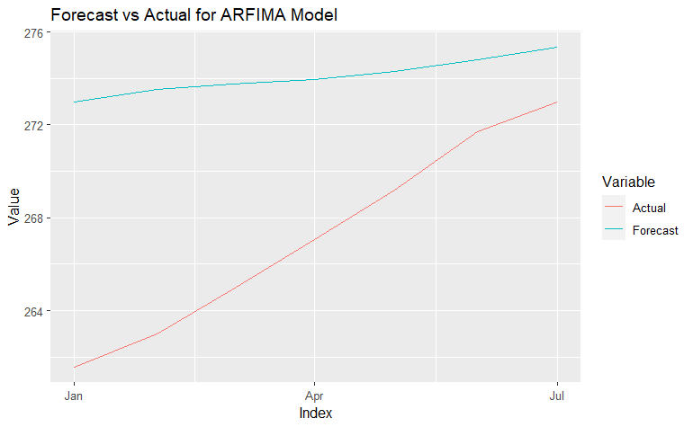
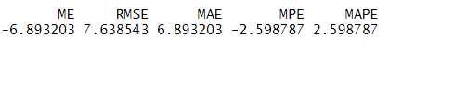
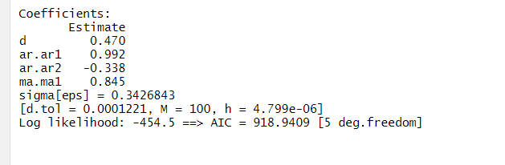
Model 3: ARFIMA
ARFIMA model has better RMSE and MAE scores than the SARIMA models. This might be due to ARFIMA ability to include long memory or long-range dependence in the data

Slide 12
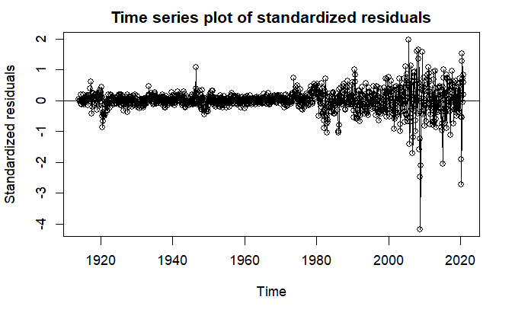
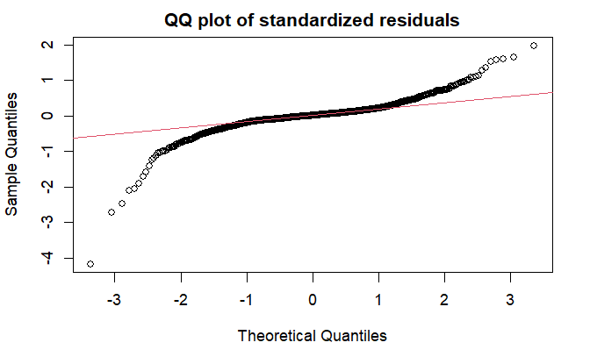
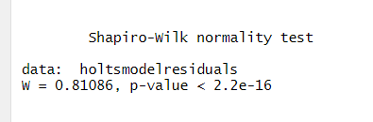
Model 4: Holt-Winters
Overview
Holt-Winter model is also great at forecasting for a time series with trend and seasonal component
Normality and Heteroscedasticity
Looking at residual plots and the Shapiro-Wilk test, normality and Homoscedastic assumptions are violated

Slide 13
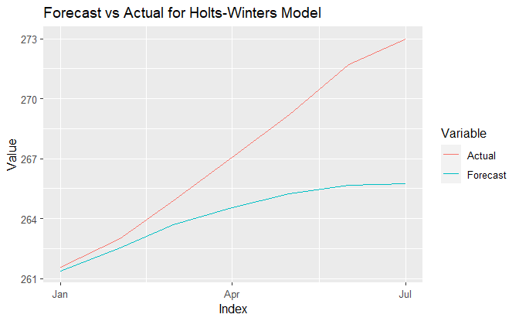
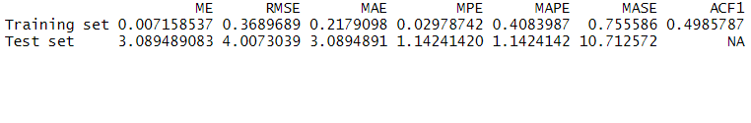
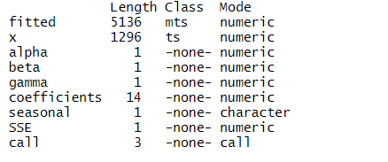
Model 4: Holt-Winters
Holt-Winters model has the best RMSE and MAE scores so far
Notes:
Hello professor and colleagues, we are the William Blair team tasked with improving the analytics of the firm.
William Blair is the premier boutique investment bank focused on middle market growth companies.
Here, Blair generates fees providing M&A advisory, as well as, raising capital through debt and equity markets
Unlike the bank's largest competitors and closest peers like Goldman Sachs, William Blair is a privately held partnership. Here, the partners risk their own capital to acquisitions, fund IPO's while providing M&A advisory.

Slide 14
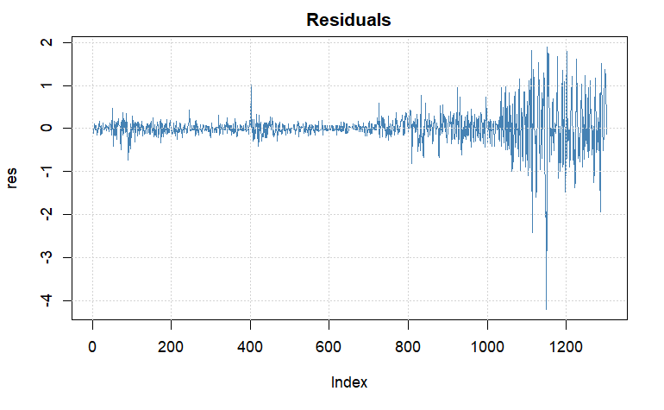
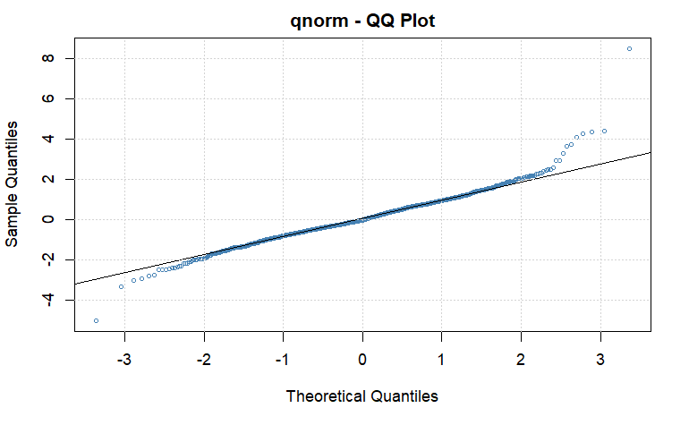
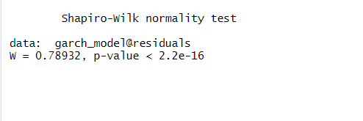
Model 5: ARMA & GARCH Combination
Overview
GARCH models are specifically designed to handle heteroskedasticity. These models allow for the variance of the errors to be time-varying. This can help to improve the accuracy of the model's predictions.
Normality and Heteroscedasticity
Looking at residual plots and the Shapiro-Wilk test, normality and Homoscedastic assumptions are violated.
Notes:
Hello professor and colleagues, we are the William Blair team tasked with improving the analytics of the firm.
William Blair is the premier boutique investment bank focused on middle market growth companies.
Here, Blair generates fees providing M&A advisory, as well as, raising capital through debt and equity markets
Unlike the bank's largest competitors and closest peers like Goldman Sachs, William Blair is a privately held partnership. Here, the partners risk their own capital to acquisitions, fund IPO's while providing M&A advisory.

Slide 15
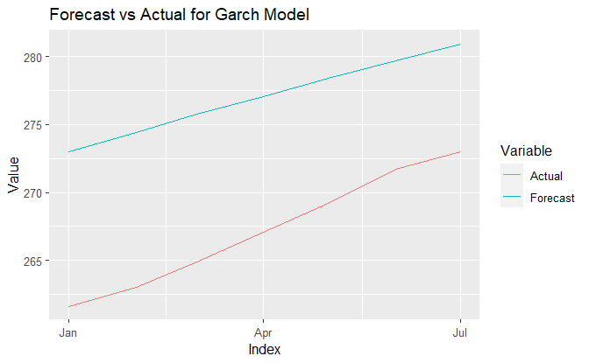

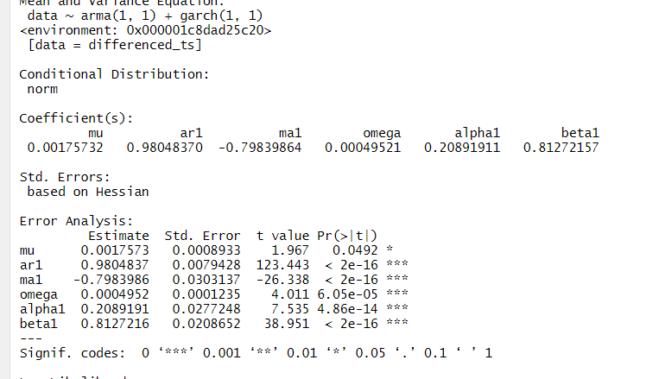
Model 5: ARMA & GARCH Combination
Holt-Winters model still has the best RMSE and MAE scores so far
Notes:
Hello professor and colleagues, we are the William Blair team tasked with improving the analytics of the firm.
William Blair is the premier boutique investment bank focused on middle market growth companies.
Here, Blair generates fees providing M&A advisory, as well as, raising capital through debt and equity markets
Unlike the bank's largest competitors and closest peers like Goldman Sachs, William Blair is a privately held partnership. Here, the partners risk their own capital to acquisitions, fund IPO's while providing M&A advisory.

Slide 16
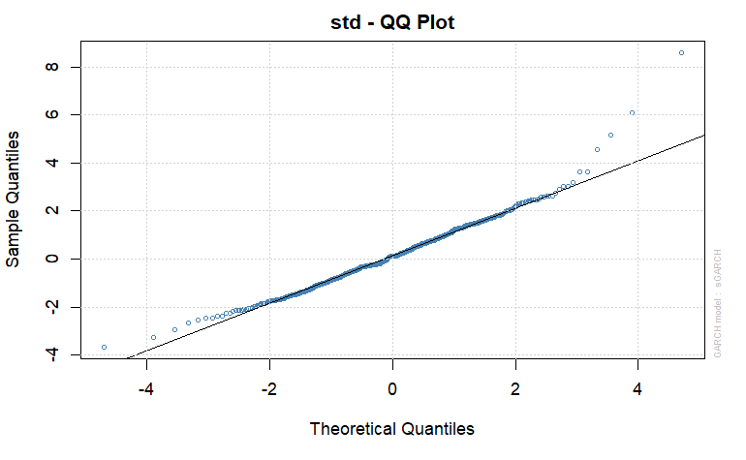
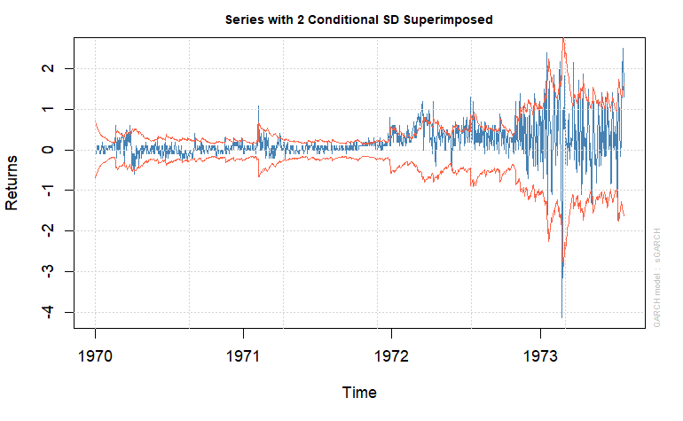
Model 6: SARIMA-GARCH Combination
Overview
Similar to ARMA-GARCH model, but this allows for seasonality
Normality and Heteroscedasticity
Looking at residual plots and the Shapiro-Wilk test, normality and Homoscedastic assumptions are violated.
Notes:
Hello professor and colleagues, we are the William Blair team tasked with improving the analytics of the firm.
William Blair is the premier boutique investment bank focused on middle market growth companies.
Here, Blair generates fees providing M&A advisory, as well as, raising capital through debt and equity markets
Unlike the bank's largest competitors and closest peers like Goldman Sachs, William Blair is a privately held partnership. Here, the partners risk their own capital to acquisitions, fund IPO's while providing M&A advisory.

Slide 17
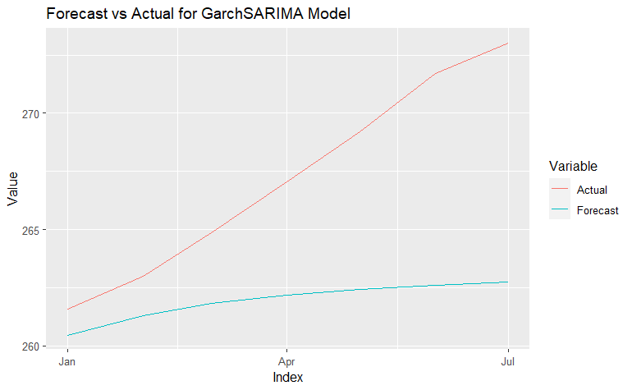

Model 6: SARIMA-GARCH Combination
Holt-Winters model has the best RMSE and MAE scores, but SARIMA-GARCH comes in a close second
Notes:
Hello professor and colleagues, we are the William Blair team tasked with improving the analytics of the firm.
William Blair is the premier boutique investment bank focused on middle market growth companies.
Here, Blair generates fees providing M&A advisory, as well as, raising capital through debt and equity markets
Unlike the bank's largest competitors and closest peers like Goldman Sachs, William Blair is a privately held partnership. Here, the partners risk their own capital to acquisitions, fund IPO's while providing M&A advisory.

Slide 18
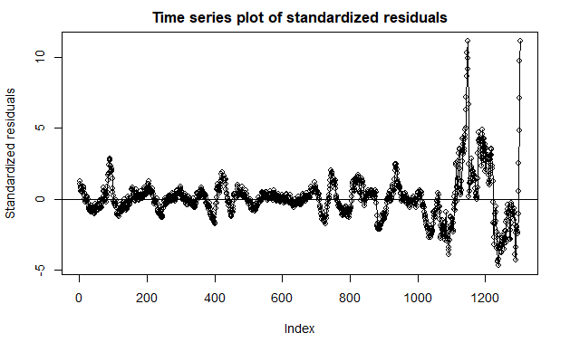
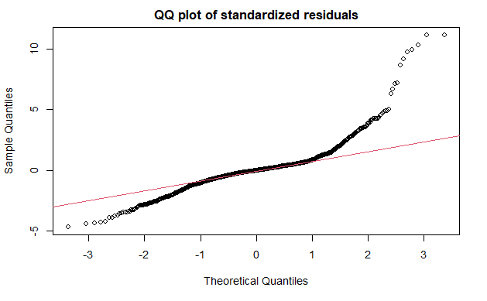

Model 7: Prophet
Overview
Another great model to try when there is trend and seasonality is the prophet model. Unlike the other models, it doesn’t have much assumptions as it is a curve fitting model.
Looking at residual plots and the Shapiro-Wilk test, normality and Homoscedastic assumptions are violated.
Notes:
Hello professor and colleagues, we are the William Blair team tasked with improving the analytics of the firm.
William Blair is the premier boutique investment bank focused on middle market growth companies.
Here, Blair generates fees providing M&A advisory, as well as, raising capital through debt and equity markets
Unlike the bank's largest competitors and closest peers like Goldman Sachs, William Blair is a privately held partnership. Here, the partners risk their own capital to acquisitions, fund IPO's while providing M&A advisory.

Slide 19

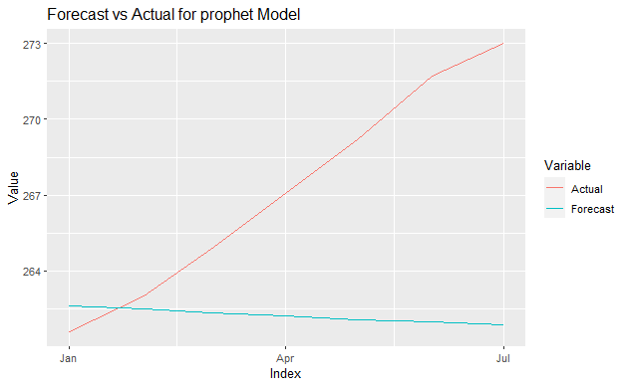
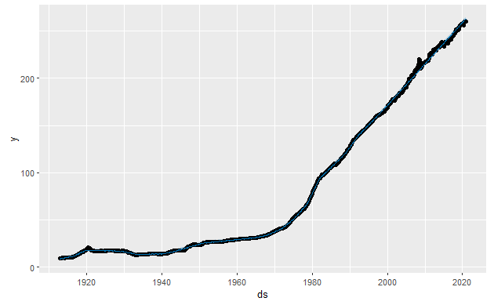
Model 7: Prophet
Holt-Winters model still has the best RMSE and MAE scores, but Prophet model has the 3rd best accuracy.
Notes:
Hello professor and colleagues, we are the William Blair team tasked with improving the analytics of the firm.
William Blair is the premier boutique investment bank focused on middle market growth companies.
Here, Blair generates fees providing M&A advisory, as well as, raising capital through debt and equity markets
Unlike the bank's largest competitors and closest peers like Goldman Sachs, William Blair is a privately held partnership. Here, the partners risk their own capital to acquisitions, fund IPO's while providing M&A advisory.

Slide 20
Model Comparison
I created 7 models in total: 2 ARIMA models, 1 ARFIMA model, 1 Holts-Winter model, 1 ARIMA-GARCH model, 1 SARIMA-GARCH model and a Prophet model. Holts-Winter had the best accuracy score looking at the RMSE and MAE scores and the forecast was decent enough. However, I pick the SARIMA-GARCH model as my final model because its accuracy is close to Holts-Winter and it is better at handling the heteroskedasticity issue.
The timeseries data was differenced to meet stationary and autocorrelation assumption for ARIMA and ARFIMA models. However, all 7 models violated the normality and homoscedastic test.
Due to time constraints, I couldn't fix the normality and homoscedastic issue. In future work, I would have like to try more GARCH models, which are good at handling heteroskedasticity. I would also further fine-tune my other models. I would have also liked to bring in another variable such as interest rate and use dynamic regression and BSTS.
Notes:
Hello professor and colleagues, we are the William Blair team tasked with improving the analytics of the firm.
William Blair is the premier boutique investment bank focused on middle market growth companies.
Here, Blair generates fees providing M&A advisory, as well as, raising capital through debt and equity markets
Unlike the bank's largest competitors and closest peers like Goldman Sachs, William Blair is a privately held partnership. Here, the partners risk their own capital to acquisitions, fund IPO's while providing M&A advisory.

Slide 21
Limitations and Future Work
Due to time constraints, I couldn't fix homoscedastic violation. In future work, I would try more GARCH models, which are good at handling heteroskedasticity
I would have also liked to bring in another variable, such as interest rate to use BSTS and dynamic regression
3) Tuning the 7 models I used might also greatly improve the forecast
Notes:
Hello professor and colleagues, we are the William Blair team tasked with improving the analytics of the firm.
William Blair is the premier boutique investment bank focused on middle market growth companies.
Here, Blair generates fees providing M&A advisory, as well as, raising capital through debt and equity markets
Unlike the bank's largest competitors and closest peers like Goldman Sachs, William Blair is a privately held partnership. Here, the partners risk their own capital to acquisitions, fund IPO's while providing M&A advisory.

Slide 22
Thank you
Check it out on GitHub!
https://github.com/rajbhanb/TimeSeriesClass/
References
https://www.currencytransfer.com/blog/expert-analysis/inflation-impact-on-the-economy
https://capital.com/inflation-definition
https://www.kaggle.com/datasets/varpit94/us-inflation-data-updated-till-may-2021
Notes:
Hello professor and colleagues, we are the William Blair team tasked with improving the analytics of the firm.
William Blair is the premier boutique investment bank focused on middle market growth companies.
Here, Blair generates fees providing M&A advisory, as well as, raising capital through debt and equity markets
Unlike the bank's largest competitors and closest peers like Goldman Sachs, William Blair is a privately held partnership. Here, the partners risk their own capital to acquisitions, fund IPO's while providing M&A advisory.

